Slide 1


`
Introduction to Reverse Shells
A reverse shell is a type of malware that allows an attacker to control a compromised computer from a remote location. In this presentation, we'll explore how reverse shells work, the differences between reverse TCP and regular TCP connections, and more.
by Death Donars

Slide 2


Death Donar’s
Waqar
Hassan
Shoaib Khan

Slide 3
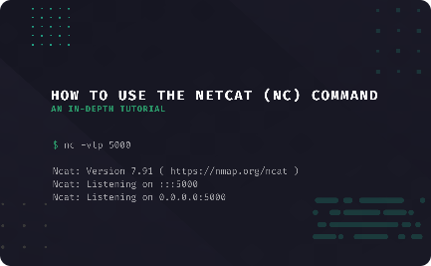
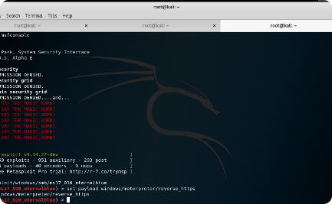
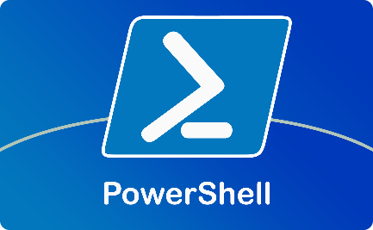
Meterpreter is an advanced reverse shell with many features. It’s often used alongside the Metasploit framework for hacking and security testing.
Examples of Popular Reverse Shells
Netcat
Meterpreter
PowerShell
Netcat is one of the most widely used reverse shells. It's a simple and powerful tool that can be used for a variety of tasks.
Meterpreter is a highly advanced reverse shell that provides a wide range of features and capabilities. It's commonly used in conjunction with the Metasploit framework.
PowerShell is a Windows tool for automation and scripting. It can also be used to create reverse shells for remote control or malicious purposes.

Slide 4
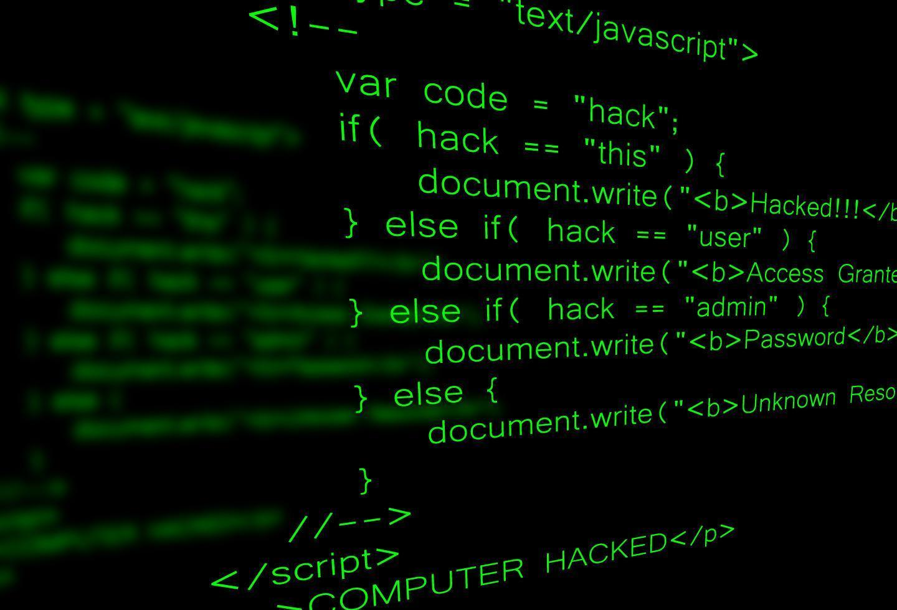
How Reverse Shells Work
1
Attack Initiation
The attacker initiates the attack by sending a payload to the victim's computer. This payload typically contains the code necessary to establish a reverse shell.
2
Victim Infection
Once the victim's computer has been compromised, the payload is executed, and the malware begins to run in memory. This allows the attacker to interface with the malware and begin communicating with the victim's computer.
3
Remote Control
With the malware running, the attacker has full control over the victim's computer. They can execute commands, gather sensitive information, and even use the compromised computer as a launchpad for further attacks.

Slide 5
What is Reverse TCP Connection?
TCP Connection
Reverse TCP Connection
Difference Between TCP and ReverseTCP
A TCP connection is a standard network connection that uses a client-server model. When a client wants to communicate with a server, it initiates the connection, and the server responds.
A reverse TCP connection, on the other hand, is initiated by the victim's computer. It connects back to the attacker's server, allowing the attacker to bypass firewalls and other network security measures.
The main difference between TCP and reverse TCP is the direction of the network connection. With TCP, the client initiates the connection, but with reverse TCP, the server initiates the connection.

Slide 6
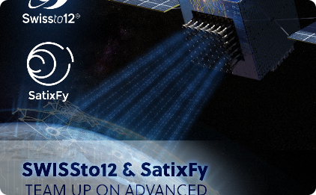
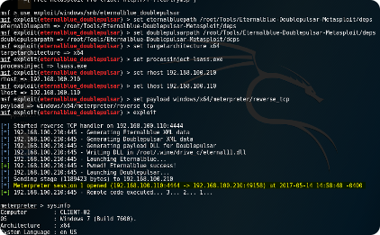
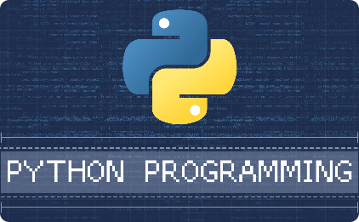
Generating Payloads for Reverse Shells
What is a Payload?
Generating Payloads with Metasploit
Generating Payloads with Python
A payload is a piece of code sent to the victim's computer for execution. It often includes commands for establishing a reverse shell or other malicious activities. commands that the attacker wants to run on the compromised computer.
Metasploit is a framework for creating payloads for reverse shells. It provides tools to craft payloads for various operating systems. However, default payloads may be detected by antivirus programs like Windows Defender unless obfuscated.
Python is a versatile programming language often used to create payloads for reverse shells. Attackers use techniques like obfuscation or encryption to bypass antivirus tools and avoid detection.

Slide 7

Conclusion
1
Reverse shells are a powerful tool for attackers.
They allow attackers to control compromised computers from a remote location.
2
There are many different types of reverse shells.
These range from simple command-line tools to advanced malware frameworks.
3
Generating payloads for reverse shells requires knowledge of programming and network security.
Tools like Metasploit and Python can help simplify the process.

Slide 8
Let's progress to the practical demonstration of
gaining reverse shell access to the victim's computer,
achieved by injecting a payload.

